Slide 1
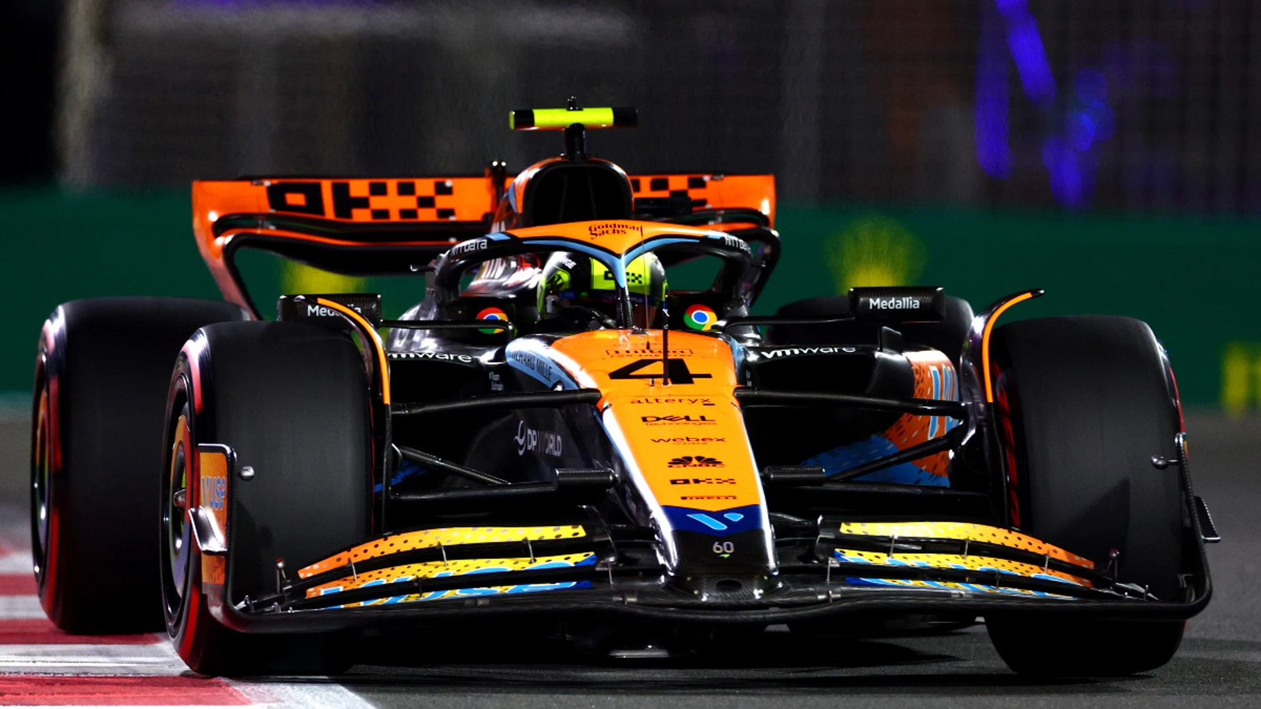



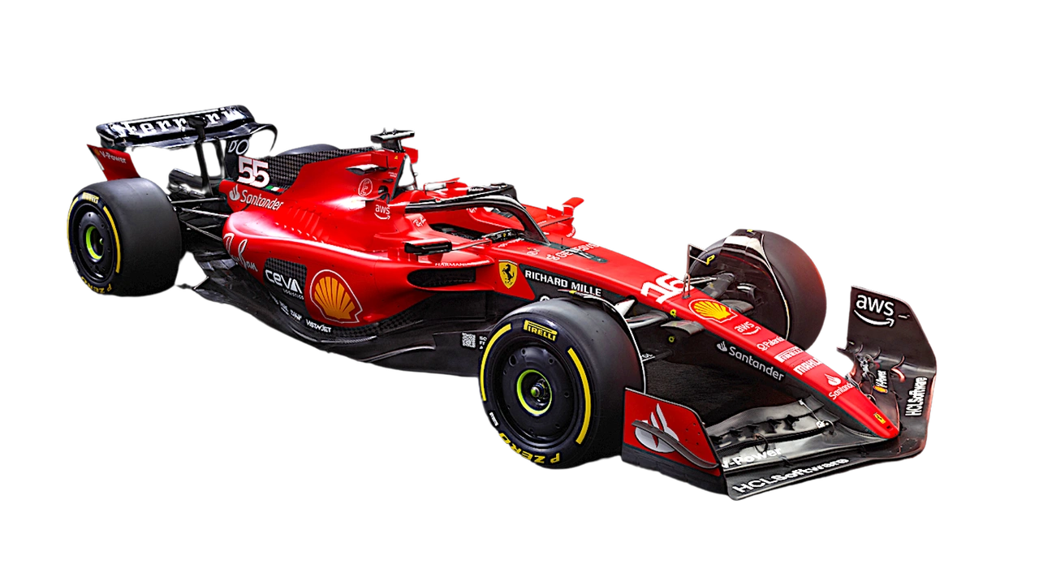
F1LLM
Automotive LLM Model
F1LLM
Davide Benotto – 332150
Manuele Mustari - 319694
Paolo Riotino - 332530

Slide 2

F1LLM
OBJECTIVES
An AI solution for precise POST-SESSION ANALYSIS to enhance racing performance
A Large Language Model (LLM) that efficiently processes telemetry data for RAPID INSIGHTS
TIME-SAVING support for telemetrists with EFFICIENT data analysis

Slide 3

F1LLM
VALUE PROPOSITION
Anticipate the Unseen: DETECT anomalies in order to PREDICT future failures before they become setbacks.
Optimize Potential: SIMULATE, SHAPE, and REFINE the perfect lap by uncovering deeper insights to COMPARE and EVOLVE strategies for continuous improvement.
Our project aligns with SDG 9 by leveraging advanced AI to drive innovation, improve efficiency, and support SUSTAINABLE practices in modernizing motorsport performance and infrastructure.

Slide 4
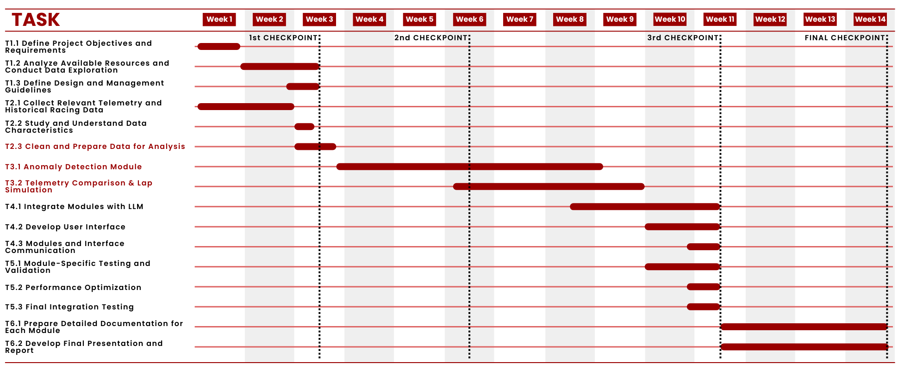



UPDATED GANTT
F1LLM
Charles
DRIVER
Finds technical data hard to translate into improvements on the track
Alex
TELEMETRIST
Giusy
COACH
Lacks actionable data directly supporting psychological and physical coaching
Overwhelmed by data volume, making real-time issue detection difficult.

Slide 5
F1LLM
TARGET AUDIENCE
Charles
DRIVER
Finds technical data hard to translate into improvements on the track
Alex
TELEMETRIST
Giusy
COACH
Lacks actionable data directly supporting psychological and physical coaching
Overwhelmed by data volume, making real-time issue detection difficult.

Slide 6


F1LLM
TARGET AUDIENCE
Charles
DRIVER
Finds technical data hard to translate into improvements on the track
Alex
TELEMETRIST
Giusy
COACH
Lacks actionable data directly supporting psychological and physical coaching
Overwhelmed by data volume, making real-time issue detection difficult.

Slide 7
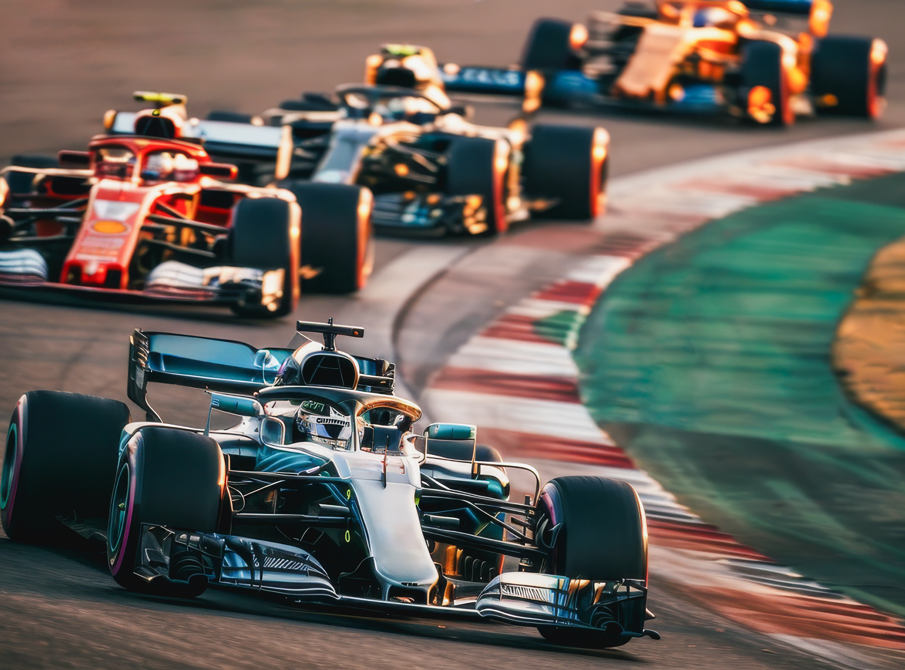
F1LLM
DATASET
Charles
DRIVER
Finds technical data hard to translate into improvements on the track
Giusy
COACH
Lacks actionable data directly supporting psychological and physical coaching

Slide 8






F1LLM
FASTF1
KEY FEATURES
SESSION DATA
TELEMETRY AND CAR DATA
LLM
VISUALIZATION
TRACK & WEATHER CONDITIONS
TABULAR DATA

Slide 9

F1LLM
MODULES
LLM

Slide 10


F1LLM
MODULES
ANOMALY DETECTION
LAP SIMULATION
TELEMETRY COMPARISON

Slide 11
ANOMALY DETECTION
F1LLM
HYPOTHESIS & DEVELOPMENT CHOISES
DETECTION
1
CLASSIFICATION
2

Slide 12
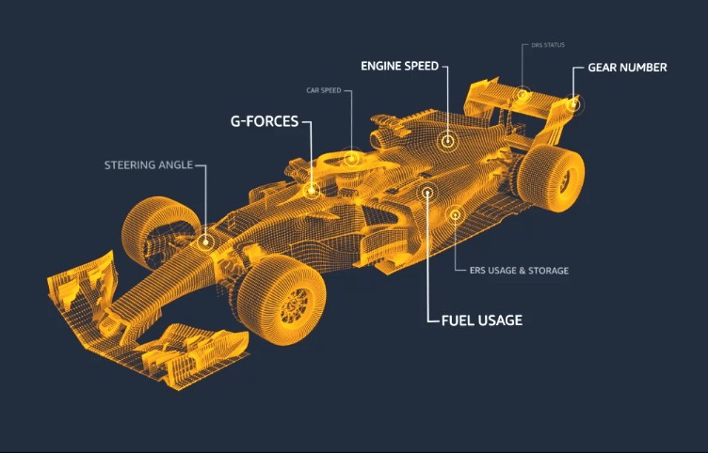
ANOMALY DETECTION
F1LLM
HYPOTHESIS & DEVELOPMENT CHOISES
DETECTION
1
UNSUPERVISED anomaly detection model to find TELEMETRY IRREGULARITIES
Telemetry data* includes:
CAR DATA (e.g. speed, throttle, tyre pressure, brake)
WEATHER DATA (e.g. temperature, humidity)
*For each year, event and driver

Slide 13
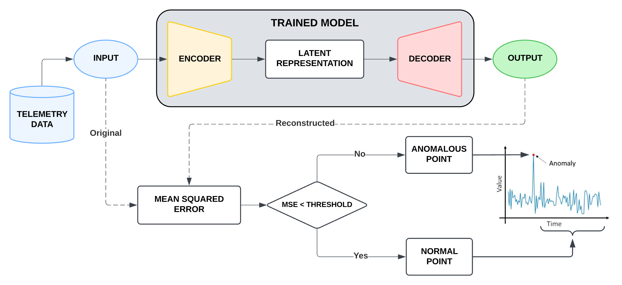
F1LLM
AUTOENCODER

Slide 14
ANOMALY DETECTION
F1LLM
HYPOTHESIS & DEVELOPMENT CHOISES
CLASSIFICATION
2
Propose a FAILURE CATEGORY that can be identified and CLASSIFIED based on the anomalies DETECTED in the data
45
different anomalies
8
failure groups

Slide 15



CLASSIFICATION MODEL
F1LLM
HYPOTHESIS & DEVELOPMENT CHOISES
RANDOM FOREST
SVM and NEURAL NETWORK
ANOMALY DETECTION
LAP SIMULATION
TELEMETRY COMPARISON
PROS:
EASY to implement
INTERPRETABLE
Can be used as a BASELINE
CONS:
LIMITED for sequential data
LOW PERFORMANCE
IGNORES feature intercorrelations
PROS:
Powerful for COMPLEX PATTERNS
Adaptable to HIGH-DIMENSIONAL data
Considers feature INTERACTIONS
CONS:
Computationally EXPENSIVE
LESS INTERPRETABLE
DIFFICULT to tune

Slide 16
F1LLM
MODULES
ANOMALY DETECTION
LAP SIMULATION
TELEMETRY COMPARISON

Slide 17

F1LLM
MODULES
ANOMALY DETECTION
LAP SIMULATION
&
TELEMETRY COMPARISON

Slide 18

LAP SIMULATION
&
F1LLM
TELEMETRY COMPARISON
HYPOTHESIS & DEVELOPMENT CHOISES
LAP SIMULATION
1
TELEMETRY COMPARISON
2

Slide 19
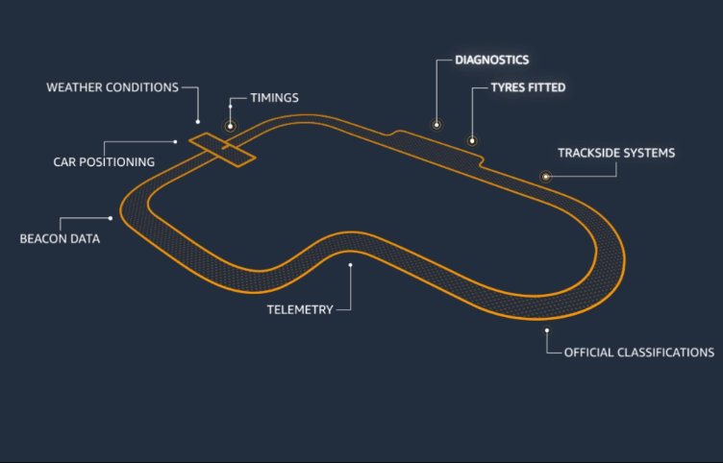
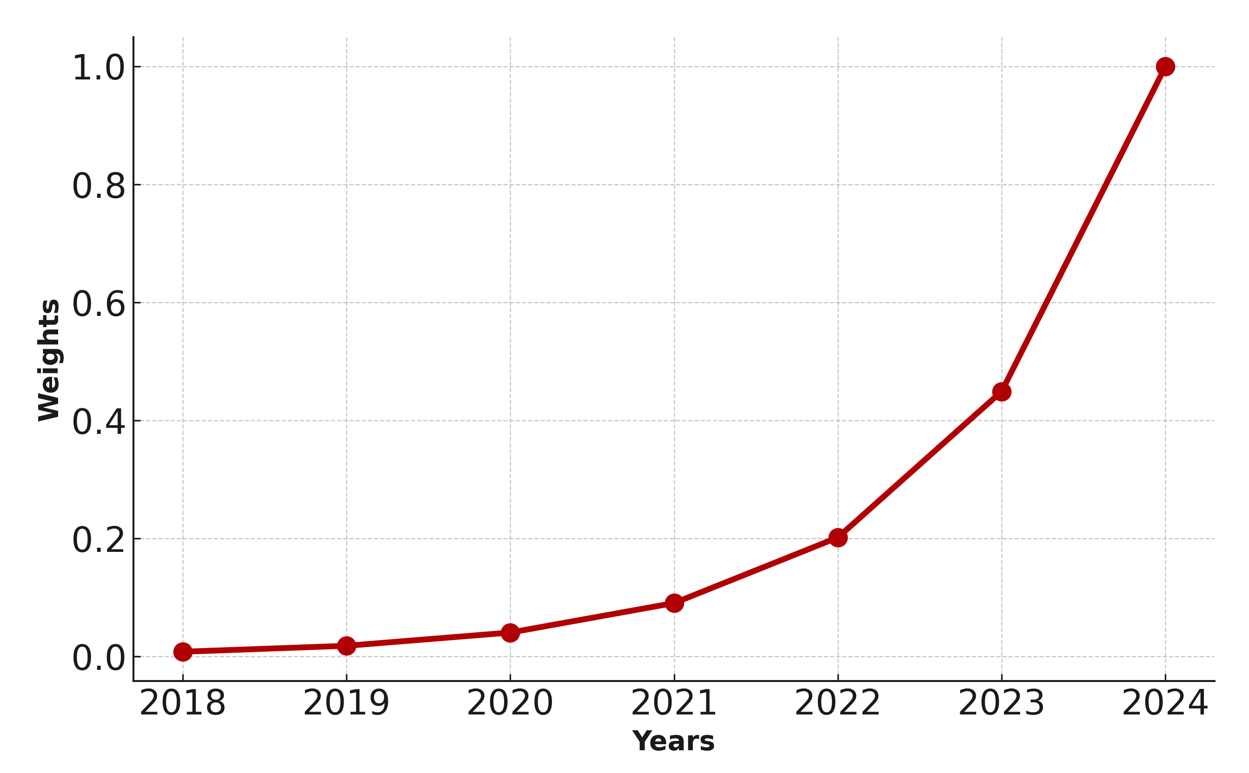
LAP SIMULATION
TELEMETRY COMPARISON
&
F1LLM
HYPOTHESIS & DEVELOPMENT CHOISES
LAP SIMULATION
1
Analyzing historical qualifying data to predict CAR PERFORMANCE
Greater emphasis on RECENT results weighted EXPONENTIALLY to capture CONTEMPORARY trends.

Slide 20
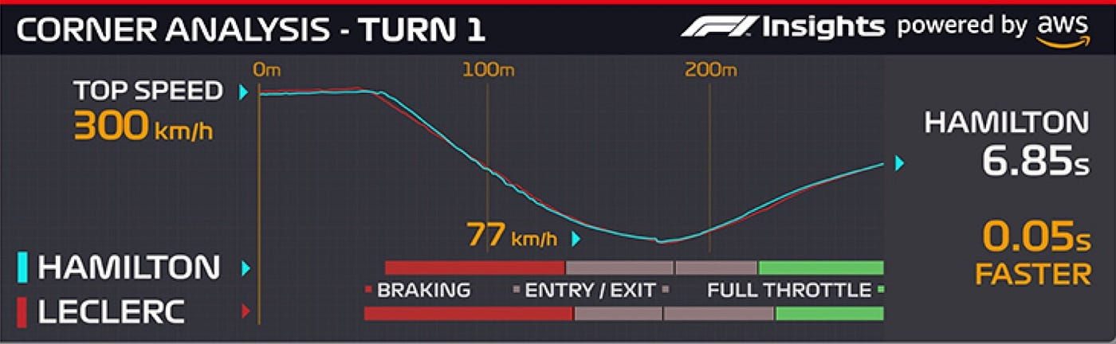
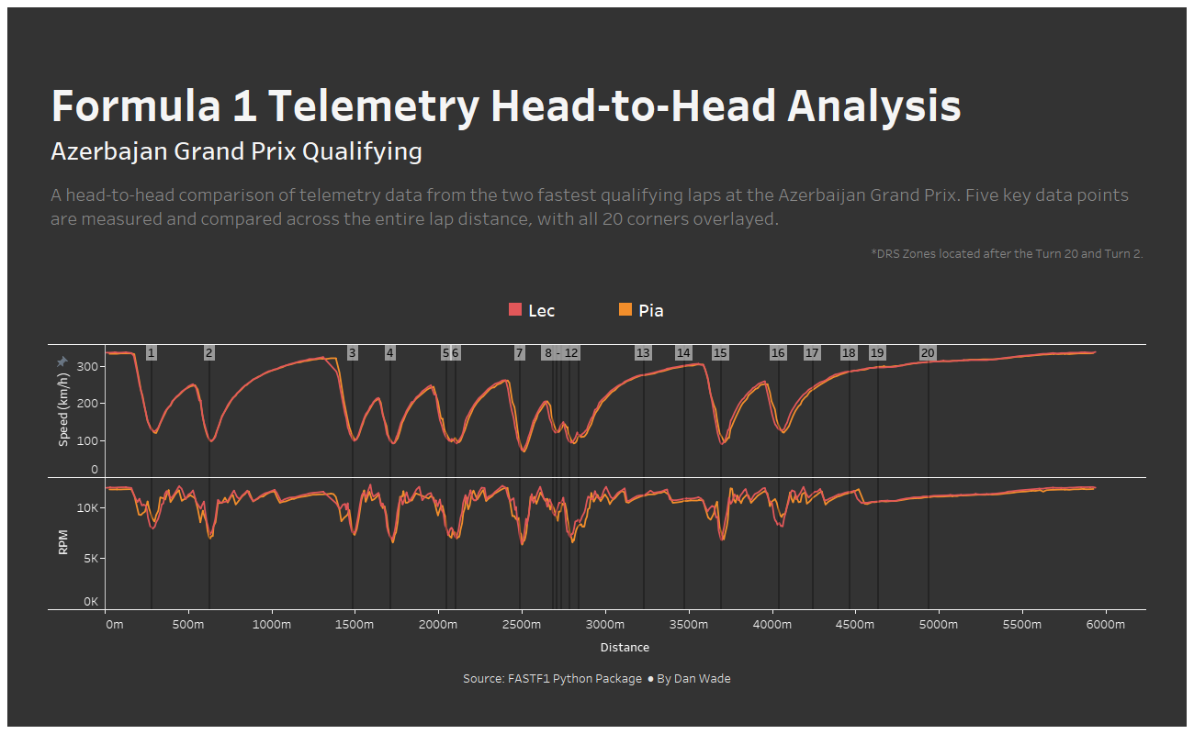
LAP SIMULATION
TELEMETRY COMPARISON
&
F1LLM
HYPOTHESIS & DEVELOPMENT CHOISES
TELEMETRY COMPARISON
2
Evaluation through TEAMMATE PERFORMANCE analysis
Comparison with FASTER DRIVERS
OBJECTIVE: give to driver some KEY ADJUSTMENTS on his guidance

Slide 21
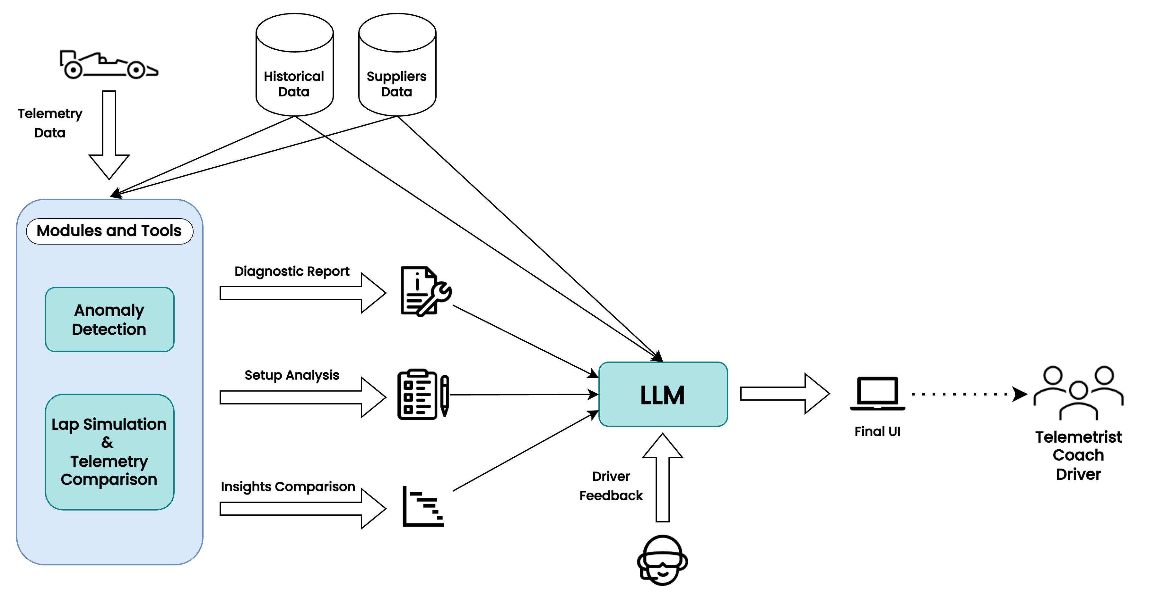
UPDATED FUNCTIONAL DIAGRAM
F1LLM

Slide 22
THANK YOU
FOR YOUR ATTENTION
F1LLM

